Slide 1
Analysis of Death risk factors
DATA 230 Term Project Presentation
Group 3
Iqra Bismi
Megha Gupta
Saniya Lande
Madhura Pandit

Slide 2
Overview
Introduction
Objective
Dataset
Methodology
Analysis
Results
Inference

Slide 3

Introduction
History of worldwide mortality rate
Various causes of deaths observed worldwide due to different parameters.
Leading Parameters of Death
Air Pollution
Child mortality
Dietary habits
Lifestyle choices

Slide 4
Objective
Identify leading factors of deaths.
Compare and analyze correlation between different parameters.
Effect of development indicators such as GDP and population on mortality rates.
Forecast to analyze the trend of major affecting parameters.

Slide 5
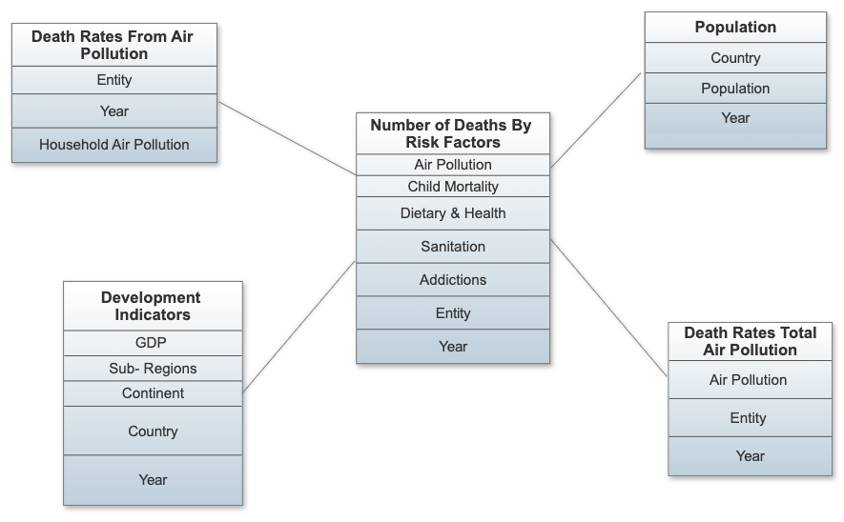
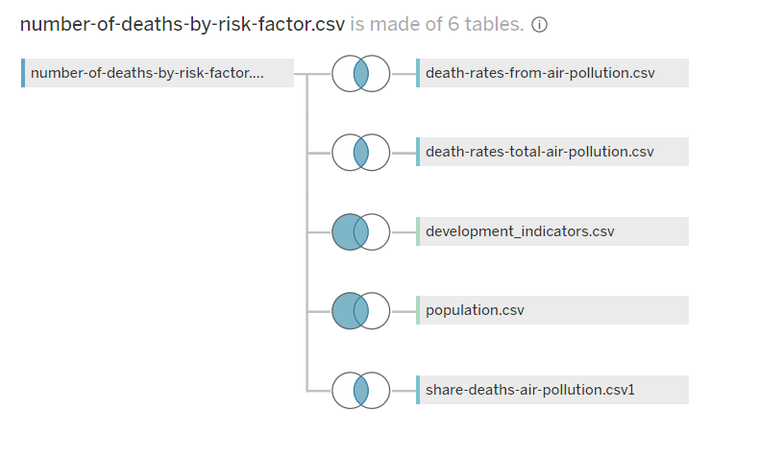
Dataset & Methodology
Data Wrangling
Joining data through Tableau
Removing nulls

Slide 6

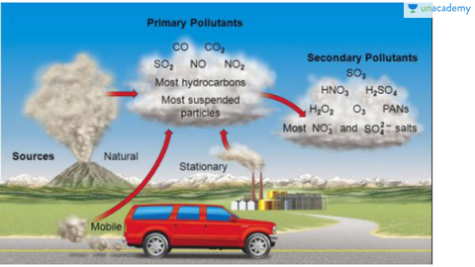

Air Pollution
Outdoor Pollution
Ozone Pollution
Matter Pollution
Household Pollution

Slide 7




Factors leading to Child Mortality
Child Stunting
Low height for their weight.
Impaired growth and development caused due to poor nutrition, improper sanitation, lack of healthcare facilities.
Child Stunting
Low height for their weight.
Impaired growth and development caused due to poor nutrition, improper sanitation, lack of healthcare facilities.
Low-birth weight
New-born babies weighing less than 5 pounds, 8 ounces (2,500 grams)
Causes: Premature birth, lack of oxygen and nutrients to baby in the womb.
Strong indicator of chronic malnutrition
Discontinued Breastfeeding
Stopping breastfeeding to infants before age of 6 months. Affects child’s growth.
Non-exclusive Breastfeeding
Feeding food or fluids in addition to breast milk other than drugs, vitamins, and minerals to infants before the age of six months.
Child Wasting
Low weight for their height
It is a sign that a child has experienced short periods of undernutrition, resulting in significant wastage of muscle and fat tissue.
Notes:
Infants who had not been fed exclusively face future health challenges. These problems cause a decrease in the full absorption of nutrients from breast milk; predispose them to diarrhea, and acu
te respiratory infections. This further contributes to weight loss; malnutrition; poor academic performance; decreased productivity; impaired cognitive, and social development
Low-birth weight : Smoking, alcohol or drug useage less than 17 years or greater than 35 years, infection during prenancy

Slide 8
Death Cases due to Dietary Habit & Health Issues
Under Poor Dietary Habits
Factors | Optimal Level of Intake
Diet-High in Sodium | 3 g (1–5) per day
Diet Low in Fruits and Nut & Seeds | 250 g (200–300) per day & 125 g (100–150) per day
Diet Low in Vegetables | 360 g (290–430) per day
Diet Low in Wholegrain | 125 g (100–150) per day
Under Health Issues
Factors | Leading Causes
High Blood Pressure & High Cholesterol | Due to diet high in salt, fat, and/or cholesterol; chronic conditions etc
High Plasma Glucose | Due to stress, lack of exercise, eating junk food
High BMI & Low Physical Activity | Due to diet, lack of exercise, stress
Low Bone Mineral Density | Due to smoking, alcohol, age, poor diet, medications

Slide 9
Madhura

Slide 10
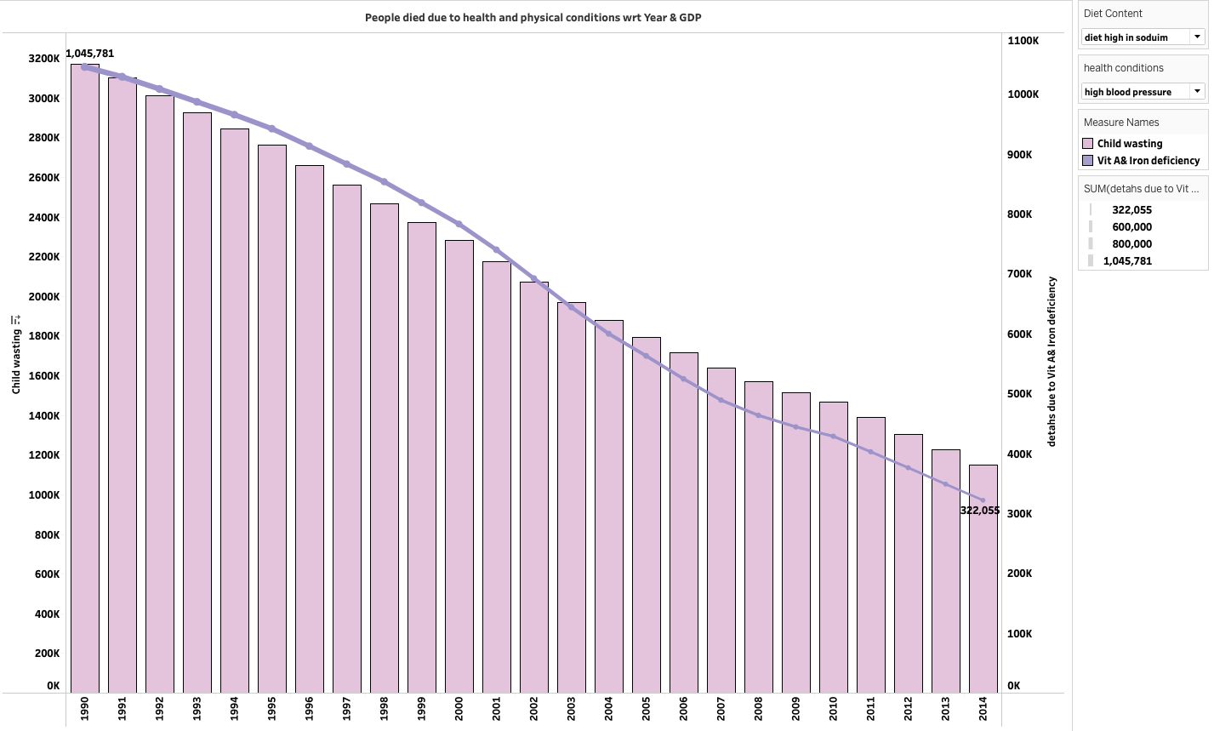
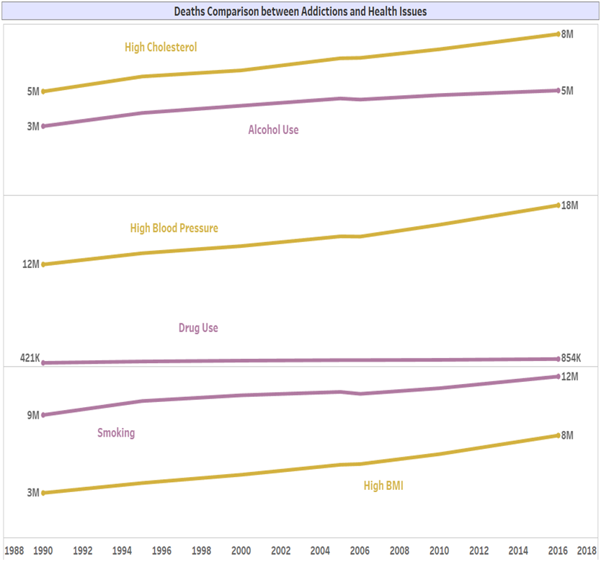
Results
Deaths due to child stunting & low vitamin and iron deficiency
Deaths due to Addictions vs Health Issues

Slide 11
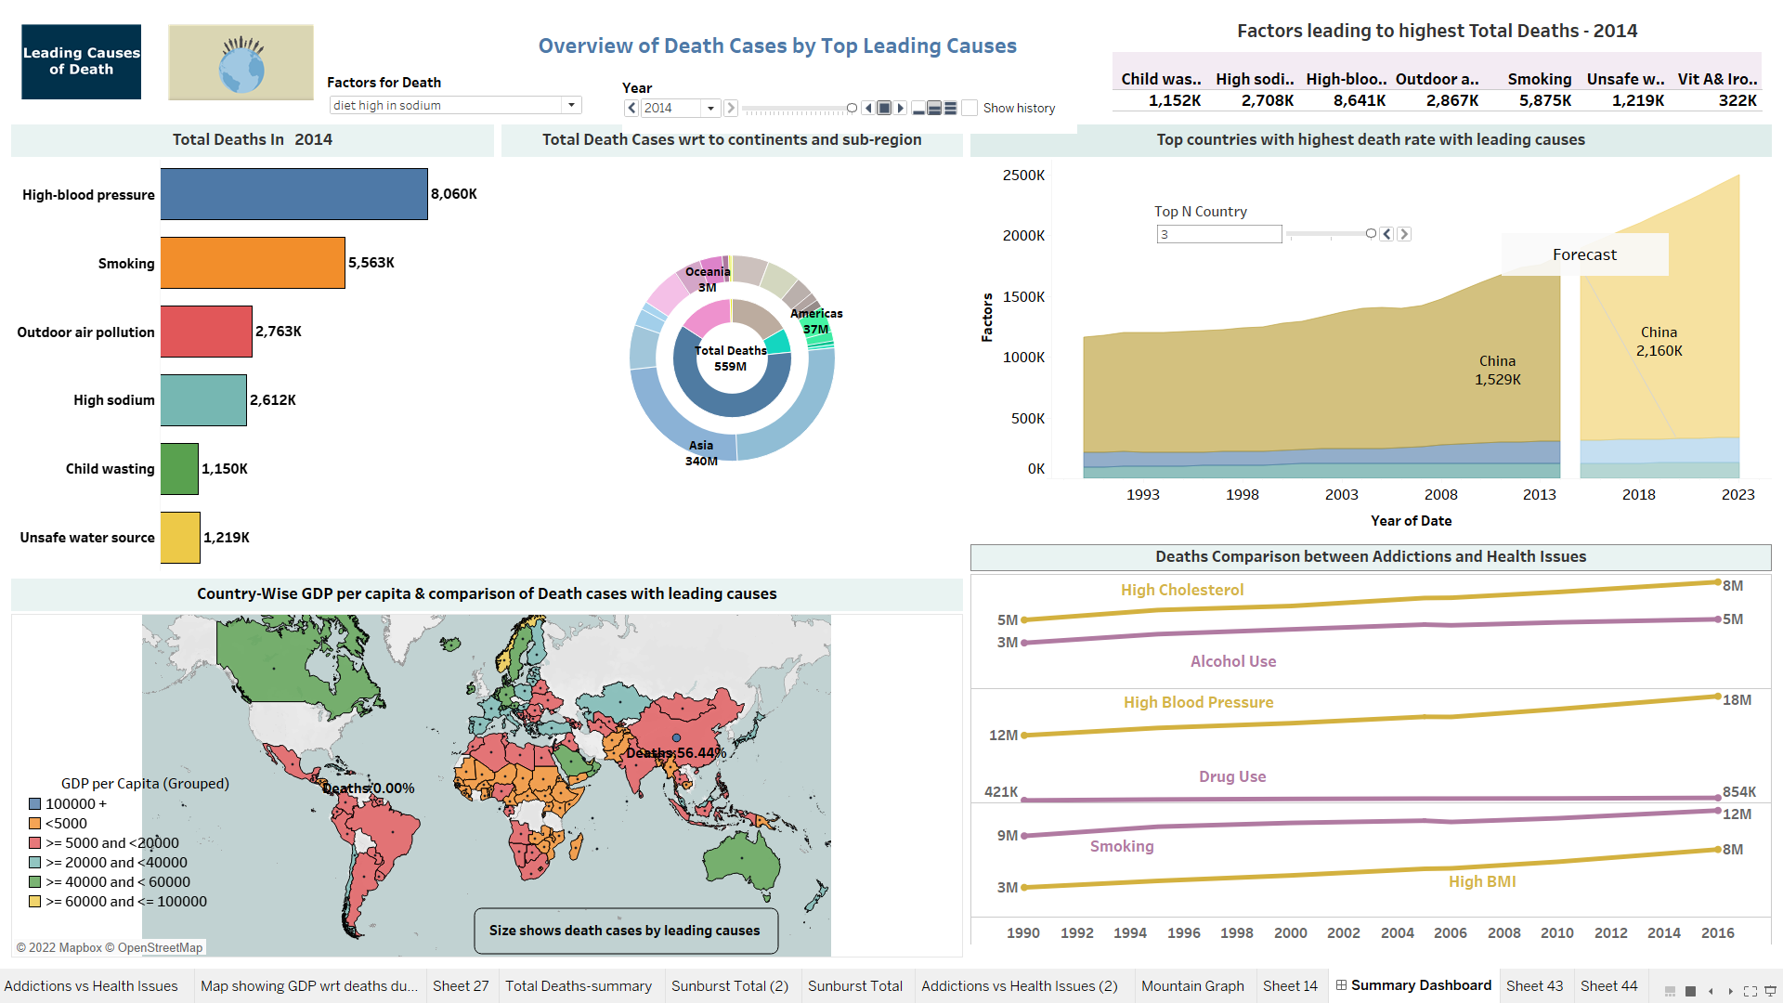
Results

Slide 12
Inferences
Highest deaths in -----
Diet content
Developed and Developing countries
Population

Slide 13
Thank You

